Slide 1

Stockie: Stock Trading System
STOCKIE
The Money-Making Machine
Flatiron Final Project
By
Frank Kornet
frkornet@gmail.com
https://www.linkedin.com/in/frank-kornet-7a152221/
Notes:
I enjoy watching science fiction movies. One of the movies that I took inspiration from is called Chappie by Neil Blomkamp (2015, South Africa).
In Dutch “ie” is typically used to make something small and cute, e.g. “jochie” stands for little (and cute) boy.
In honor of this movie, I am calling my trading system Stockie. The picture on the front slide shows Chappie with the name Stockie on top of it.
I also like the name Stockie as it acknowledges that this is a small system compared to trading systems operated by large stock market players.

Slide 2
Trading Strategy
Notes:
The mimes show the importance of buying and selling the stock at the right time. If you do that right, you can make money. In fact: lots of money!
The trading strategy pursued by Stockie is buy low and sell high. It does this based on data, and not what market commentators saying or what market analysts are selling. This is an important distinction.

Slide 3
Topics
Why a Stock Trading System?
Stockie’s Trading Performance
Notes:
The mimes show the importance of buying and selling the stock at the right time. If you do that right, you can make money. In fact: lots of money!
The trading strategy pursued by Stockie is buy low and sell high. It does this based on data, and not what market commentators saying or what market analysts are selling. This is an important distinction.

Slide 4
Topics
Why a Stock Trading System?
Envisaged => Implemented Trading System
Learnings and Findings
Stockie’s Trading Performance
Limitations & Issues
Version 2 Blueprint
Acknowledgements
Notes:
The mimes show the importance of buying and selling the stock at the right time. If you do that right, you can make money. In fact: lots of money!
The trading strategy pursued by Stockie is buy low and sell high. It does this based on data, and not what market commentators saying or what market analysts are selling. This is an important distinction.

Slide 5
Why a Stock Trading System?
Oracle Stock Options
Result: an interest in stocks
Reality: stock markets are inefficient
Can we exploit these inefficiencies?
Time Series Widely Applicable
MBA
Pay part of my first house
Capital Asset Pricing Model
Notes:
I started investing in stocks in my twenties as a result of Oracle stock options. It was a world that I did not learn until then. I was surprised how valuable options and stocks could be.
CAPM implies markets are efficient and developing a trading strategy to beat the market is futile since the market is a random walk.
Stock markets are efficient to a large degree, but at the same time they are inefficient to a higher degree than most recognize.
Time series are applicable in : sales forecasts, well logs, medical records, etc

Slide 6
Envisaged Trading System
Sold Stocks
Ledger
(P & L)
Update
Local Max
Confirmed
Buys
Confirmed
Buys
Daily Sell
Recommendations
Hourly Stock
Data
Top Daily
Buy Recommendations
Market Trend
Up
Sideways
Down
E(ret)
Momentum
E(ret)
Swing
Up
2moro
Up in
3 days
Up in
5 days
Up in
10 days
Local
Min
Local
Max
Set of 100 stocks
Notes:
Components:
- The blue parts were developed as part of Module 4 project, giving final project a head start
- Two types of models envisaged to predict whether stocks are going up or not
- The middle part integrates both recommendations to identify buy opportunities
- The top part shows that buy decisions are verified by a human and then added to ledger after buying
The trading system reads the stock prices from Yahoo Finance. The system uses the python yfinance library as a wrapper for accessing Yahoo Finance. More details can be found at https://pypi.org/project/yfinance/.
The list of tickers was derived from Renaissance Technologies’ F-13 Filing. This is a quarterly filing that is open to the public and documents all the stocks owned by Renaissance Technologies. All large players have to file this to the SEC and are publicly accessible through the Edgar database.
The F13 filings use CUSIP numbers instead of stock tickers. Yahoo Finance uses stock tickers instead of CUSIP numbers. As a result, I had to convert CUSIP numbers to stock tickers. The following website (https://quotes.fidelity.com/mmnet/SymLookup.phtml?QUOTE_TYPE=D) can be used to convert CUSIP numbers to stock ticker symbols. To automate that, a web scraper has been developed.

Slide 7
Implemented Trading System
backtest_nnn
heuristic
ticker
stats
backtest
exclude
data quality
capital
PnL
possible
trades
Jupyter notebook
Python
CSV file
Notes:
Components:
- 2,000 stocks instead of 100
- Backtesting engine
- Forecasting with ARX/GARCH model
- Local minima and maxima models
- P&L functionality to track performance
- Buy recommendations (but not sell)
- Hourly updates

Slide 8

Learnings & Findings
STOCKIE
The Money-Making Machine
Performance gets better as more stocks are added
ARX/GARCH forecasting capability is weak and hence excluded
Local minima and maxima model turns out to be great
The buy recommendation functionality simplified as a result
Stop-loss used to manage downside risk
Heuristics used to differentiate between good and bad stocks
Ranking stocks using mean daily compounded returns of gains

Slide 9
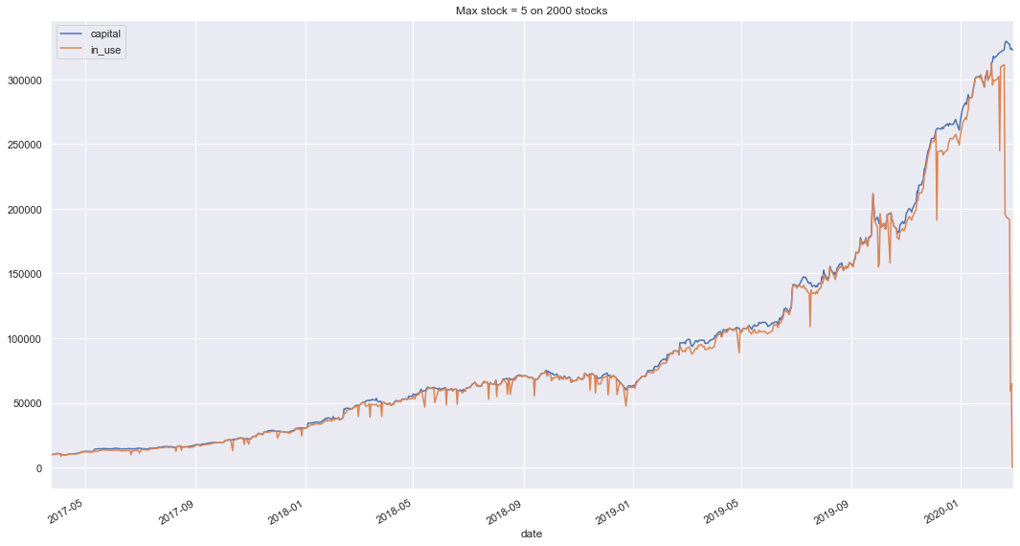
Stockie’s Trading Performance
Starting capital: $10k
Trading period: 732 days
The best result to date: $320k
Compounded daily return: 0.4 – 0.5 % / day
Notes:
Note that the chart is only showing (buy and sell pairs). This is why you see the in use line dropping at the end of the chart.
253 trading days per year.
0.4 % daily compounded return = 175 % p.a. (excluding initial capital)
0.5 % daily compounded return = 253 % p.a. (excluding initial capital)

Slide 10
Limitations and Issues
Backtester function complex and large
Stockie has proven itself in backtesting
Still to implement:
sell recommendations, rebalancing, capping holding period if a certain gain has been achieved, limiting number of trading days, and portfolio management
Literature claims ARX/GARCH models are good at predicting stock prices. Neural networks claimed to be even better.
The heuristics restrict the 2,000 stocks to 436 good stocks
Notes:
Literature claims NN are better at predicting stock market prices. That may be true, but they are also more complex (what features they are precisely using...?)
NB: not shown and covered, but I developed a Markov Chain model to predict stock market prices prior to Module 4. When considering ARX/GARCH and NN models, we also need to revisit this part. Perhaps a mixture of models works best?

Slide 11
Version 2 Blueprint
Util
PnL
PnL + capital
Strategy
Trade
Heuristic
possible
trades
exclude
ticker stats
Quality
Jupyter notebook
Python
CSV file
Not included: ARX/GARCH, NN, and portfolio management
Notes:
Enhancements:
- Break up the code & simplify backtester
- Implement sell recommendations, rebalancing, capping holding period, and limiting trading days
- Running jobs in background
- Add BlackRock stocks from F-13 filings
Estimated Effort & Timeline:
Takes 2 – 3 weeks to implement. After that we can start testing how well Stockie does in predicting future stock movements.
Not included: ARX/GARCH, NN, and portfolio management

Slide 12
Acknowledgements
Bryan Arnold for his help and ideas. They were instrumental in developing Stockie.
Carson Lloyd for developing a web scraping template for converting CUSIP numbers to stock tickers. They saved me a ton of time.

